Slide 1
Performing radiation therapy research using the open-source SlicerRT toolkit
Csaba Pinter¹, Andras Lasso¹, An Wang², Gregory C. Sharp³, Kevin Alexander⁴, David Jaffray², and Gabor Fichtinger¹
¹Laboratory for Percutaneous Surgery, Queen’s University, Kingston, ON, Canada ²University Health Network, Toronto, ON, Canada
³Department of Radiation Oncology, Massachusetts General Hospital, Boston, MA, USA
⁴Department of Physics, Eng. Phys., and Astrophysics, Queen’s University, Kingston, ON

Slide 2




Bringing ideas and tools together
Routine
XiO®
Pinnacle³
Eclipse™
...
Data transfer
Conversions
2D/3D visualization
Dose analysis
Contour analysis
Segmentation, Registration
DICOM-RT
...
Research
http://SlicerRT.org

Slide 3
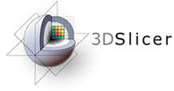
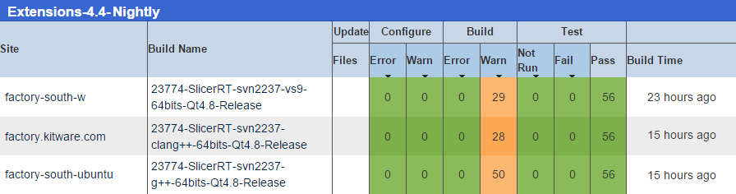
Development principles
Based on consensus discussions with RT researchers
Cover most common RT research workflows
Leverage existing tools: 3D Slicer, Plastimatch
Free, open-source license (BSD)
Open to integrate algorithms
Contribute back to community
High quality software, developed using industrial standards
S. Pieper et al. 2004
G. C. Sharp et al. 2010
SlicerRT dashboard, performing automatic testing every night

Slide 4
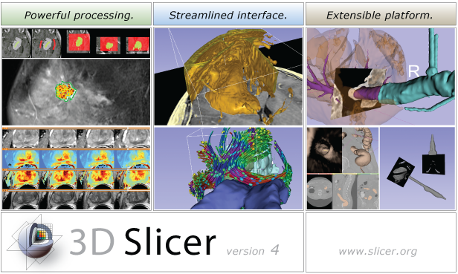
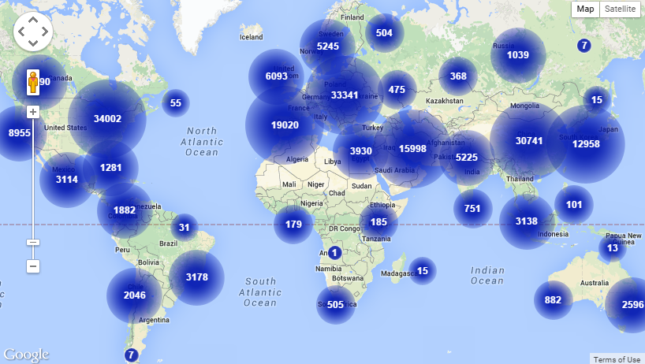
3D Slicer
Medical image analysis and visualization platform
Since 1997
$50M in funding (>2,000 years of labor)
Professionally engineered
1,000+ analysis functions
300K downloads for 4.x
www.slicer.org
3D Slicer downloads

Slide 5



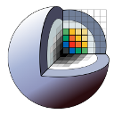

SlicerRT ecosystem
Streamlined applications
Utilities
3D Slicer
SlicerRT core
Several former SlicerRT features integrated:
Subject hierarchy, DICOM export, Transform visualizer, etc.
Common RT software tools:
DICOM-RT, Dose/Contour analysis, Beam planning, Batch processing
Acts as a platform

Slide 6
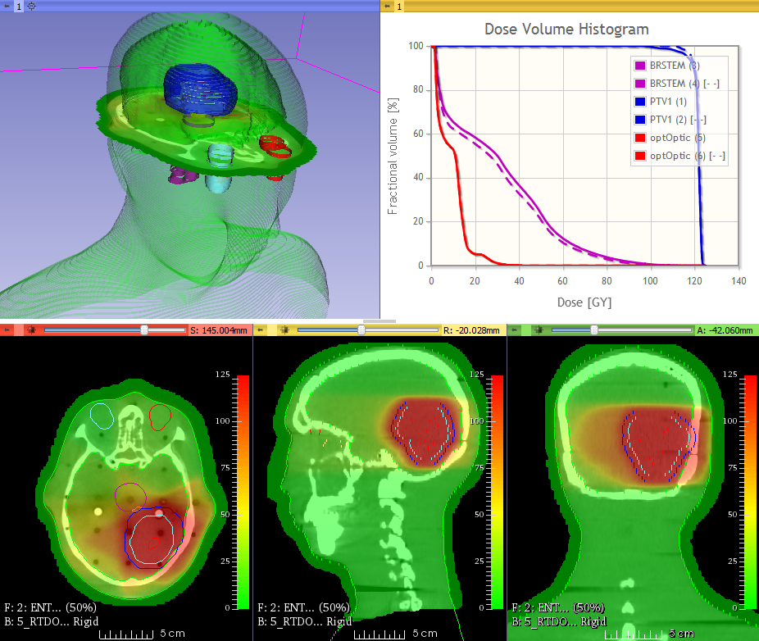
Example use case: Image-guided RT
Determine daily displacement
Evaluate dosimetric improvement (DVH, gamma)
Export patient setup correction
Collaboration with PMH, Toronto
Dosimetric improvement after patient setup correction

Slide 7
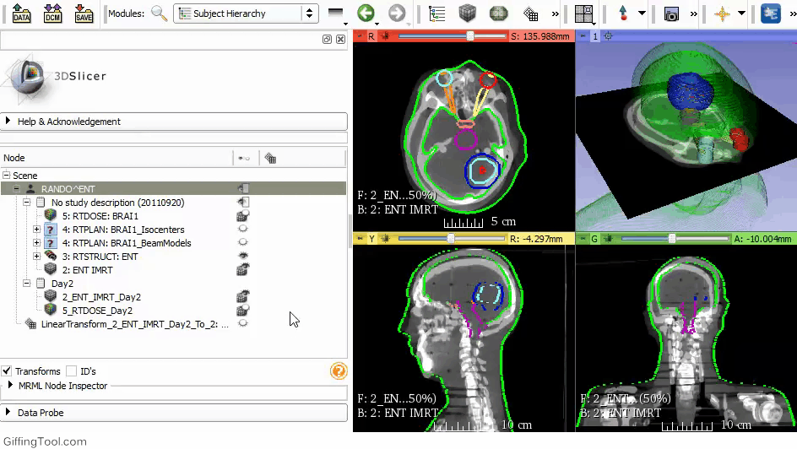
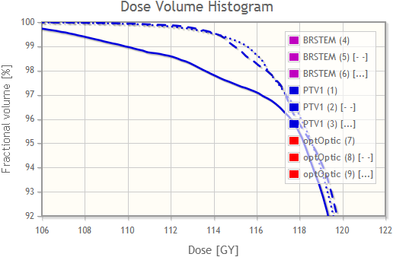
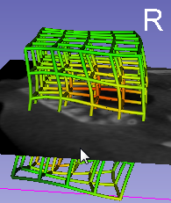
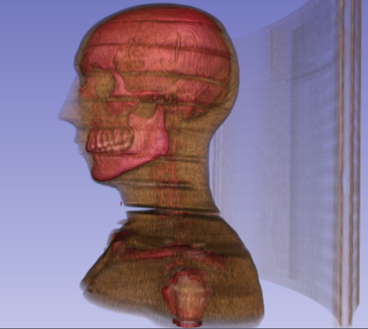
Example use case: Dose accumulation
Register anatomical images
Transform whole studies
Accumulate dose
Compute DVH
Collaboration with PMH, Toronto
Pinter et al., MedPhys, 2012
Evaluate plans using DVH
Visualize transforms, anatomy in 3D
Convenience features: Transform whole studies with a single click

Slide 8
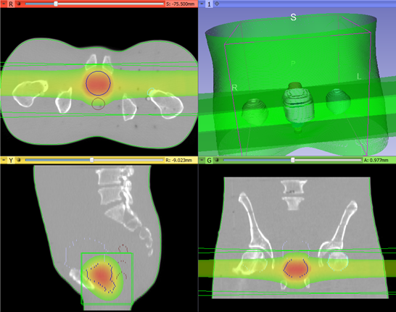
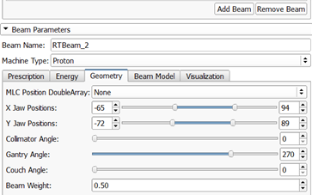
Example use case: Proton dose calculation
External beam planning
Arbitrary dose engines
Using same user interface
Potentially replace TPS
Evaluate plan
Export plan for delivery
Collaboration with MGH, Boston and CRO, Italy
Desplanques et al., MedPhys, 2014
Poster at World Congress: PS04.087

Slide 9



Example use case: SlicerRT in the cloud
Highly parallel computations
Very large amount of data
Self-driven RT scripts
Scripted analysis
Feasibility study: Find most similar daily plan from a database of plans
Initialize daily ART plan from most similar one
Andrea et al., ImNO 2015 Talk at World Congress: SP130.6
Local control

Slide 10

Example use case: Use custom MATLAB algorithm
Make MATLAB algorithms easier to use
Integrate into workflow
Rely on the power of SlicerRT and 3D Slicer
No programming
Collaboration with KGH, Kingston, ON
Alexander et al., AAPM 2015
DICOM-RT
Non-DICOM

Slide 11

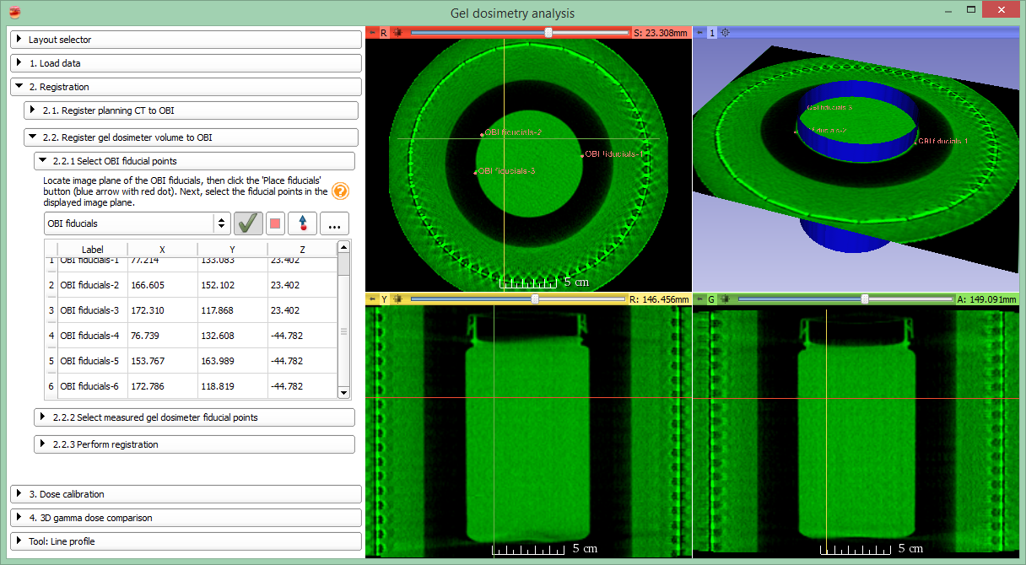
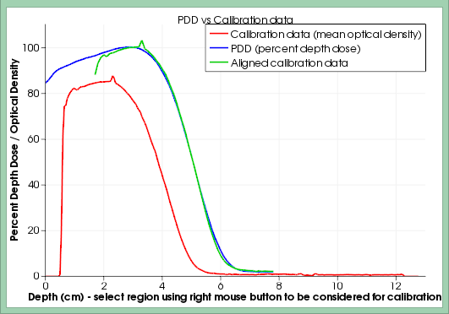
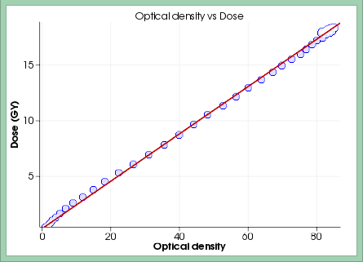
Example use case: Gel dosimetry analysis
Full 3D gel dosimetry
Simplified user interface
Collaboration with KGH, Kingston, ON
Alexander et al., IC3DDose, 2014
Talk at World Congress: SP057.3

Slide 12
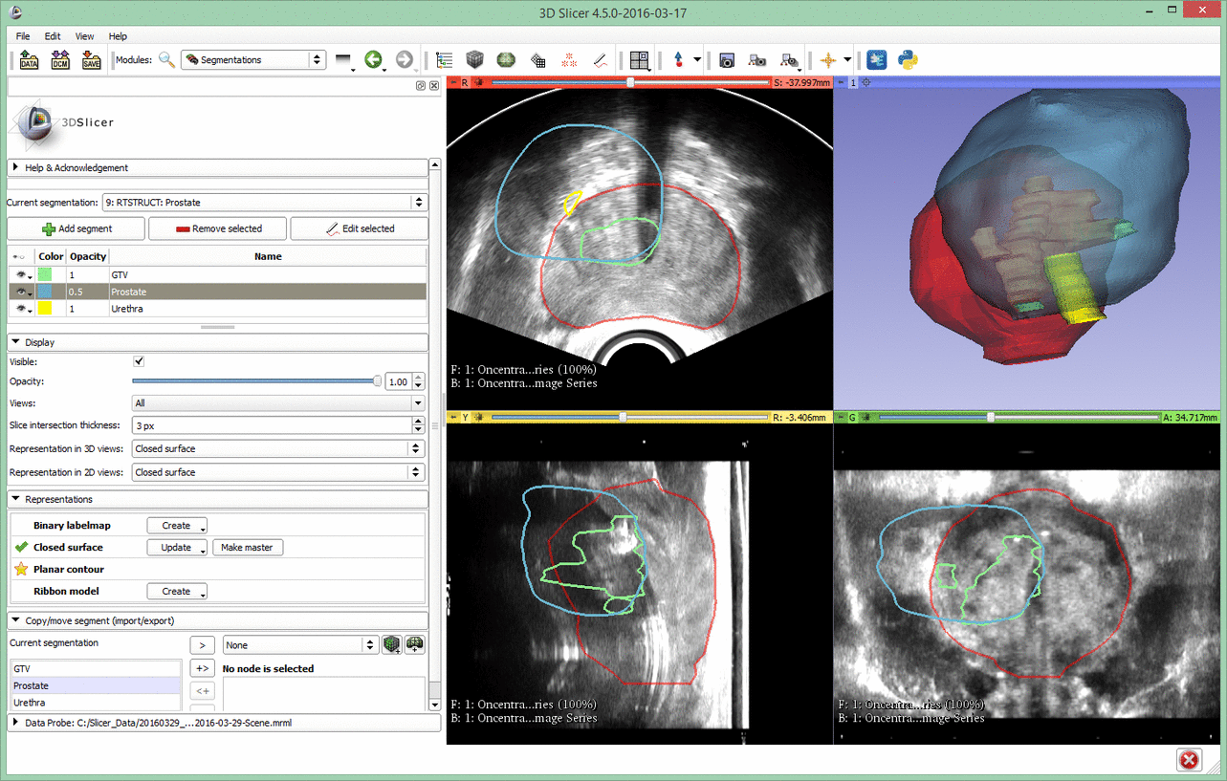
Example: MRI/US fusion for biopsy

Slide 13

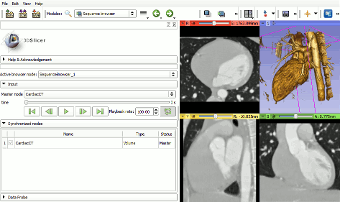
Sequences
Create and visualize of higher-dimension data nodes
RT: Multi-fraction datasets, 4D CT
Sequence browser for selection and playback
Synchronized or real-time visualization
In 2D and/or 3D
Handling of whole fraction dataset in each sequence node
Playback of a 4D cardiac CT dataset

Slide 14
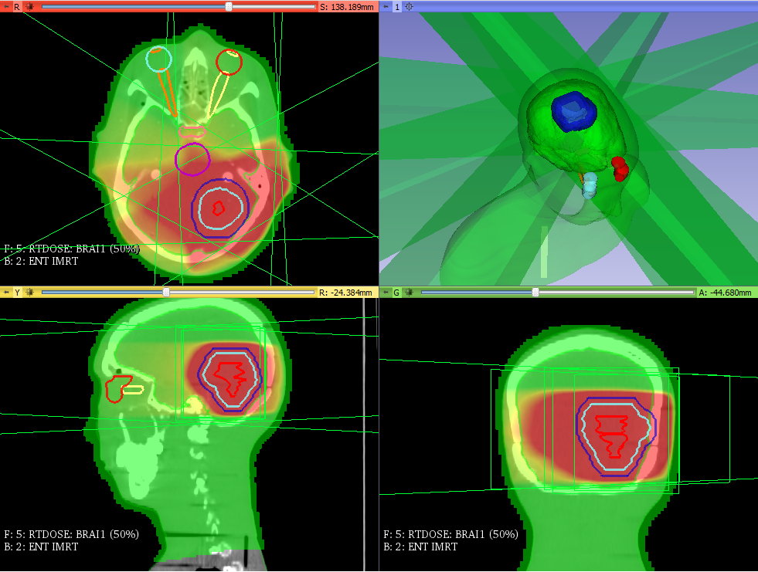
Feature group: DICOM-RT
Integrated into core DICOM import/export plugin mechanism
Supported data types:
RT structure sets → Contours → Fiducial point
RT dose map
RT image
RT plan isocenter, beams
Spatial registration
Planning CT, MR, etc.
Standard layout after loading phantom dataset
Notes:
… main feature groups of SlicerRT
The first step of every RT research workflow … … seamless handling and loading of the data using only the DICOM browser in 3D Slicer

Slide 15
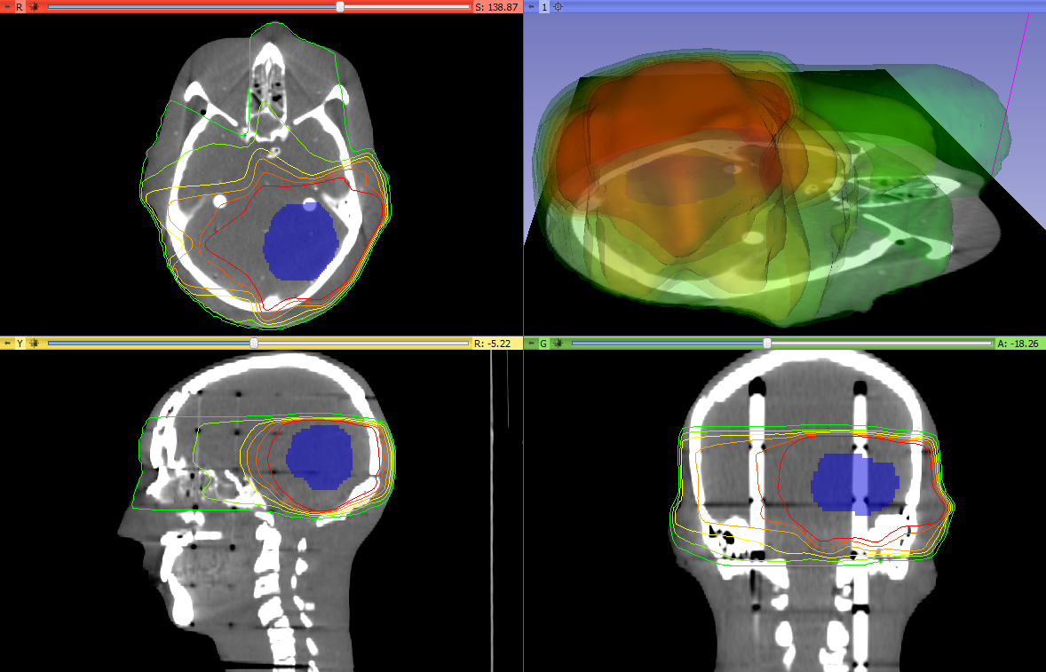
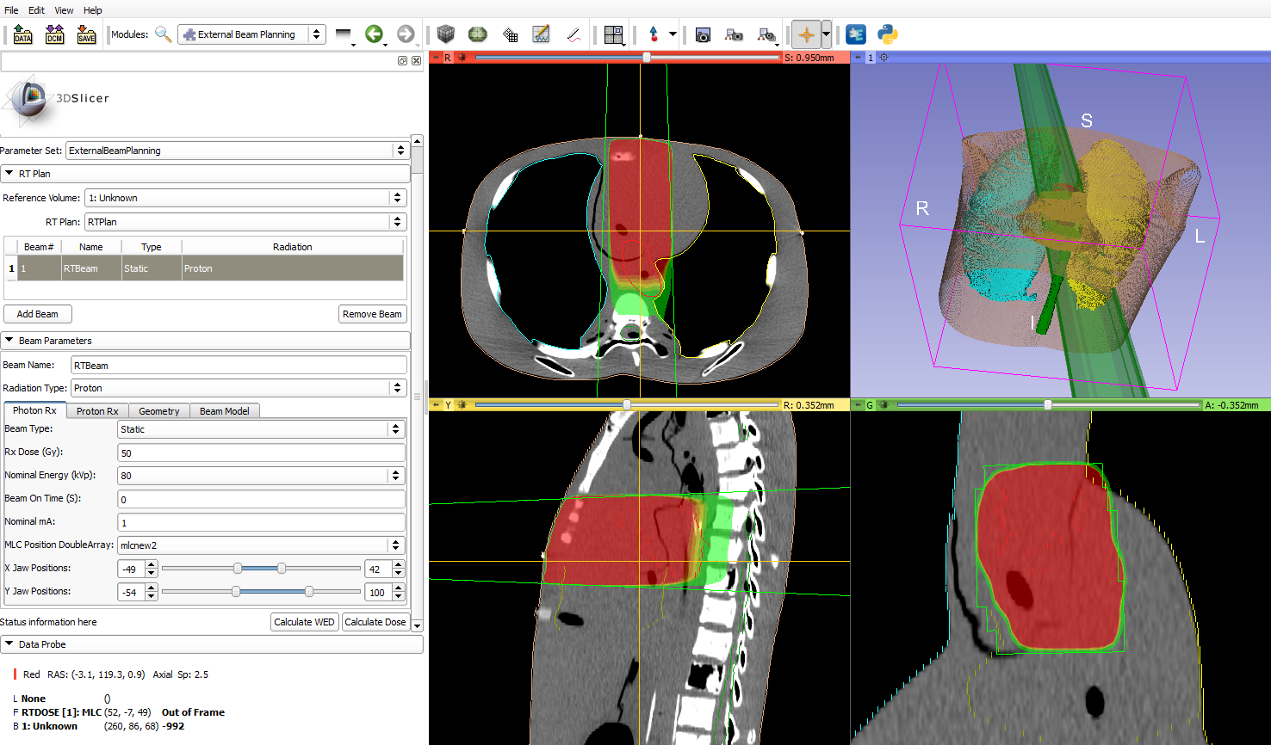
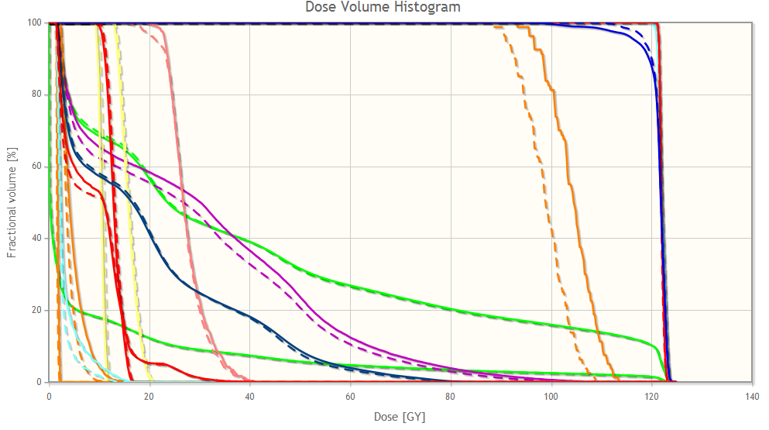
Feature group: dose analysis
Dose analysis
Dose volume histogram (DVH) calculation, comparison
Gamma dose comparison
Dose accumulation
Isodose surfaces
External beam planning platform
Isodose surfaces
Dose-volume histogram
External beam planning

Slide 16
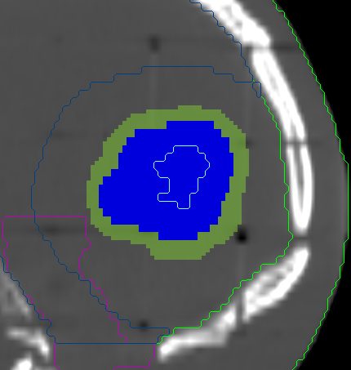
Feature group: contour analysis
Segment morphology
Expand, shrink
Combine using logical operators
Segment comparison
Dice coefficient
Hausdorff distance
Segment Morphology: Target volume expanded

Slide 17
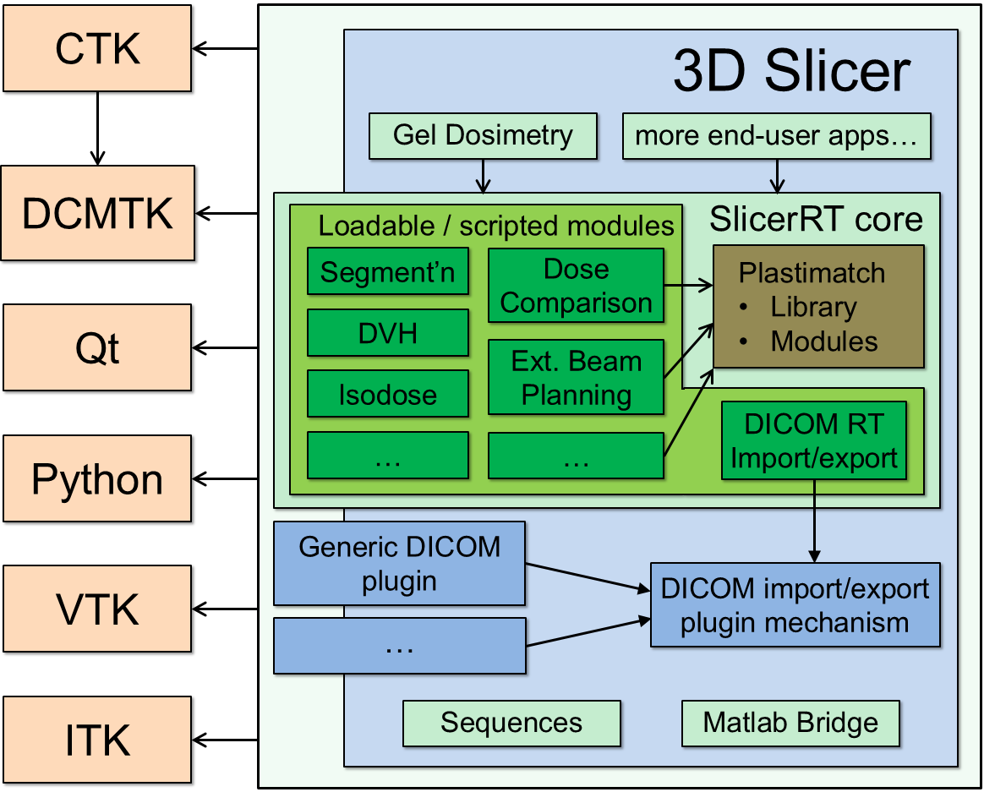
SlicerRT architecture

Slide 18
Bird’s eye view
Slicelets
(custom Slicer applets)
LumpNav
...
ProstateNav
...
Gel dosimetry
SlicerIGT
Breach warning
SlicerRT
Slicer extensions
...
Pivot calibration
Model registration
...
Tool watchdog
DICOM-RT import
Dose volume histogram
...
Dose comparison
3D Slicer
Visualization
Registration
Segmentation
...
Quantification
VTK, ITK, CTK, QT, DCMTK, …
OpenIGTLink
DICOM
PLUS
OpenIGTLink
Calibration, synchronization, pre-processing, simulation, record&replay
Device interface
software
hardware
Surgical microscopes, endoscopes
Ultrasound
scanners
Navigation
systems
Robotic devices, manipulators
MRI, CT, PET scanners
hundreds of devices (imaging, position tracking, various sensors, and manipulators)

Slide 19
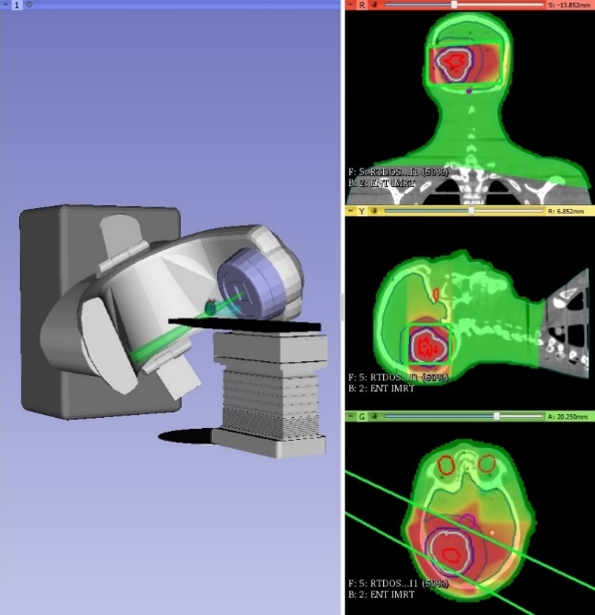
PerkLab contributions to 3D Slicer
Slicer core commits in past 3 years: 726/2912 (25%)
Extension downloads (overall, as of 2017.02.)
#1: SlicerRT: 10400
#2: SlicerIGT: 5000
#3: Matlab Bridge: 4200
#7: Volume Clip: 3300
#16: Sequences: 2200
#27: PerkTutor: 1800
#34: GelDosimetry: 1700
Average extension: 1K
View from SlicerRT
Notes:
SlicerRT is distributed as a 3D Slicer extension. It can be easily found and installed from the Slicer AppStore.

Slide 20


Thank you for your attention!
csaba.pinter@queensu.ca
http://SlicerRT.org
Please join our weekly “SlicerRT clinic” meetings

Slide 22
Appendix

Slide 23
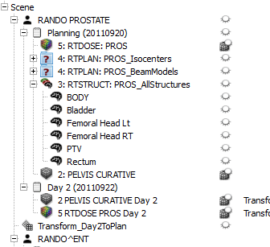
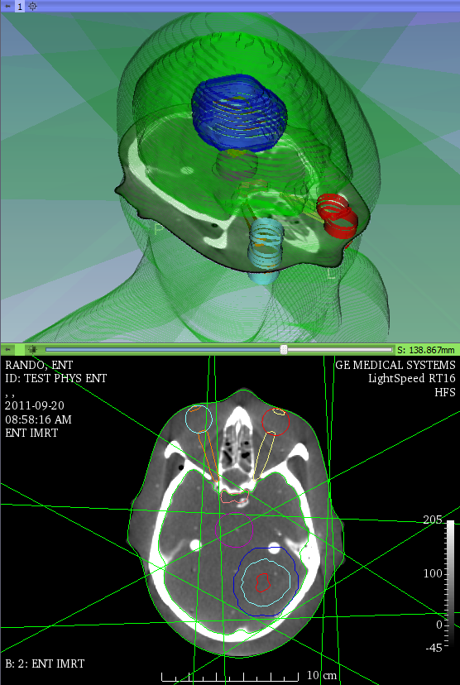
SlicerRT core highlights
Armed with the full power of 3D Slicer
DICOM-RT
Multi-fraction data handling
registration
Multi-fraction data view
Load and visualize DICOM-RT
Advanced visualizations

Slide 24
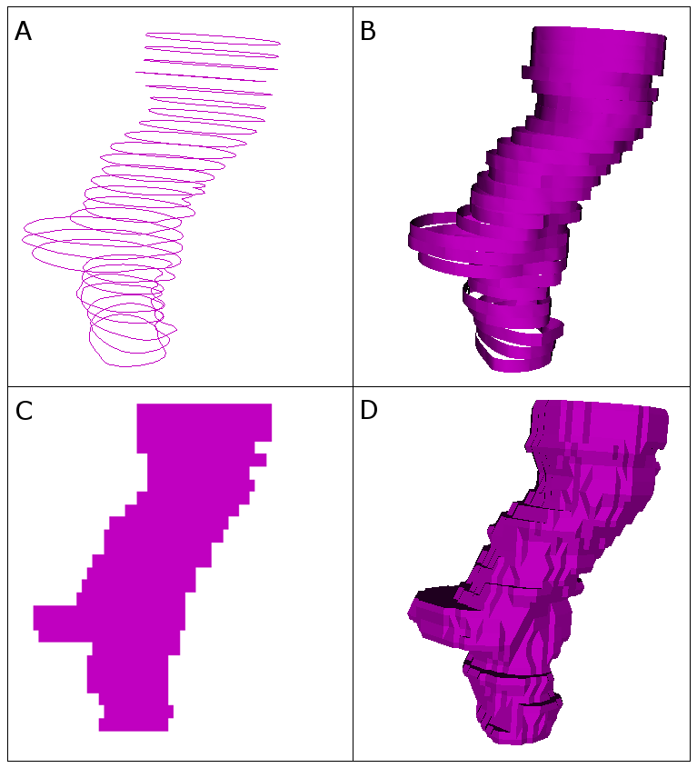
SlicerRT core highlights
Contour analysis
Multi-representation support
Morphological operators
Comparison methods
Dose analysis
DVH calculation, comparison
Gamma dose comparison
Dose accumulation
Isodose surfaces
External beam planning platform
Contour representations
Dose-volume histogram
External beam planning

Slide 25
Matlab bridge
Running Matlab functions directly from 3D Slicer
Takes input from the data loaded into Slicer
Transfers and shows the results in Slicer when MATLAB execution is completed
GUI is generated automatically from a standard command-line interface definition XML file
no GUI programming needed
No building of 3D Slicer or MEX files, etc. are needed

Slide 26
Sequences
Create and visualize of higher-dimension data nodes
RT: Multi-fraction datasets, 4D CT
Sequence browser for selection and playback
Synchronized or real-time visualization
In 2D and/or 3D
Handling of whole fraction dataset in each sequence node
Playback of a 4D cardiac CT dataset

Slide 27
Radiation therapy challenges
Research
3D Dosimetry
Computational methods
Knowledge-based RT
Image registration
Novel radiation protocols
Image/contour comparisons
?
Outcome prediction
Adaptive RT
Image segmentation
Image-guided RT
Treatment planning
Fractionation data management
Routine

Slide 28
Translational research
Commercial treatment planning systems (TPS)
Existing research tools CERR, PLUNC, dicompyler, etc.
Inconvenient
Limited feature set
Expensive
Not flexible
Insufficient user and developer support
Cover only routine clinical procedures
Open-source?
Well documented
Free
Poor documentation
Not extensible
Large, non-modular code base
Extensible
User-friendly
Closed
Stable
Flexible
Unstable
Open-source
Platform-independent
SlicerRT

